Slide 1
A Survey of
Deep Learning-Based Source
Image Forensics
Introduction
Source Camera Identification

Slide 2


Introduction
Source Camera Identification
Recaptured Image Forensic
Computer Graphics Image Forensic
GAN-generated Image Detection
Source Social Network Identification

Slide 3


Introduction

Slide 4

Introduction
Purpose
With the advent of techniques based on artificial intelligence(AI) that can be exploited by malicious actors to spread “fake news”
Past
Pattern recognition
Statistical analysis
In order to verify the authenticity and integrity of a digital image, a number of techniques, known collectively as “digital image forensics”
Recently
Deep learning-based schemes

Slide 5
Introduction
CNNs have been shown to be effective when dealing with image-related tasks, and have been subsequently adopted as a basis for numerous digital image forensics methods
did our best to collect all the related paper which have been published in journals, conferences, and arXiv. We observed that all of them have some common modules, and we proposed a unifying framework where all these schemes fit, thus simplifying their comparison.

Slide 6





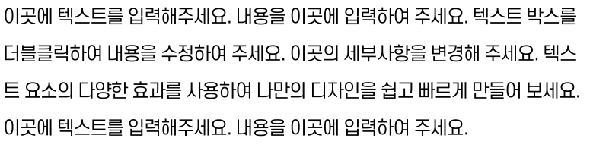
















Slide 7




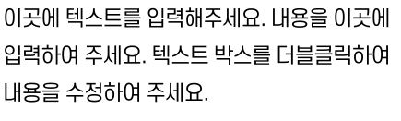

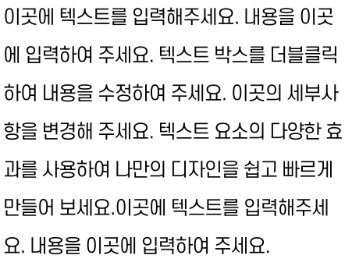




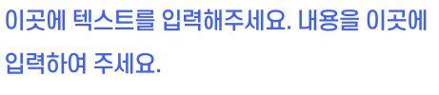

Slide 8








Slide 9



